Slide 1
Digital Portfolio
STUDENT NAME: Shruthi S
REGISTER NO AND NMID: 2428C0518, 81801B28EA6091CA6364B0896C458807
DEPARTMENT: Bsc AI&ML
COLLEGE: KPR College of Arts & Science,Bharathiar University

Slide 2
PROJECT TITLE
Political Leadership & Activism through AI & ML

Slide 3


AGENDA
Problem Statement
Project Overview
End Users
Tools and Technologies
Portfolio design and Layout
Features and Functionality
Results and Screenshots
Conclusion
Github Link
3/21/2024 Annual Review

Slide 4

PROBLEM STATEMENT
Youth voices often remain underrepresented in leadership and technology-driven initiatives.
There is a need to empower communities with education, equality, and technology solutions while fostering student leadership and social awareness.

Slide 5

PROJECT OVERVIEW
This portfolio highlights Shruthi S as a political leader, activist, and AI & ML student.
It focuses on combining leadership with technology to bring innovation, awareness, and positive social change.

Slide 6

WHO ARE THE END USERS?
Students interested in AI, ML, and activism
Political and social activists
Educational communities
Organizations promoting youth leadership and social change

Slide 7

TOOLS AND TECHNIQUES
Web Technologies: HTML, CSS (for portfolio design)
AI & ML Knowledge (academic focus)
Communication & Leadership Skills
Design Tools: Canva / Figma (optional for portfolio layout)

Slide 8
POTFOLIO DESIGN AND LAYOUT
Dark theme with yellow highlights
Sections: About Me, Vision & Activism, Education, Contact
Clean, professional, and modern layout

Slide 9
FEATURES AND FUNCTIONALITY
Clear presentation of personal background & achievements
Emphasis on vision for activism & leadership
Highlights academic journey in AI & ML
Contact information for networking

Slide 10

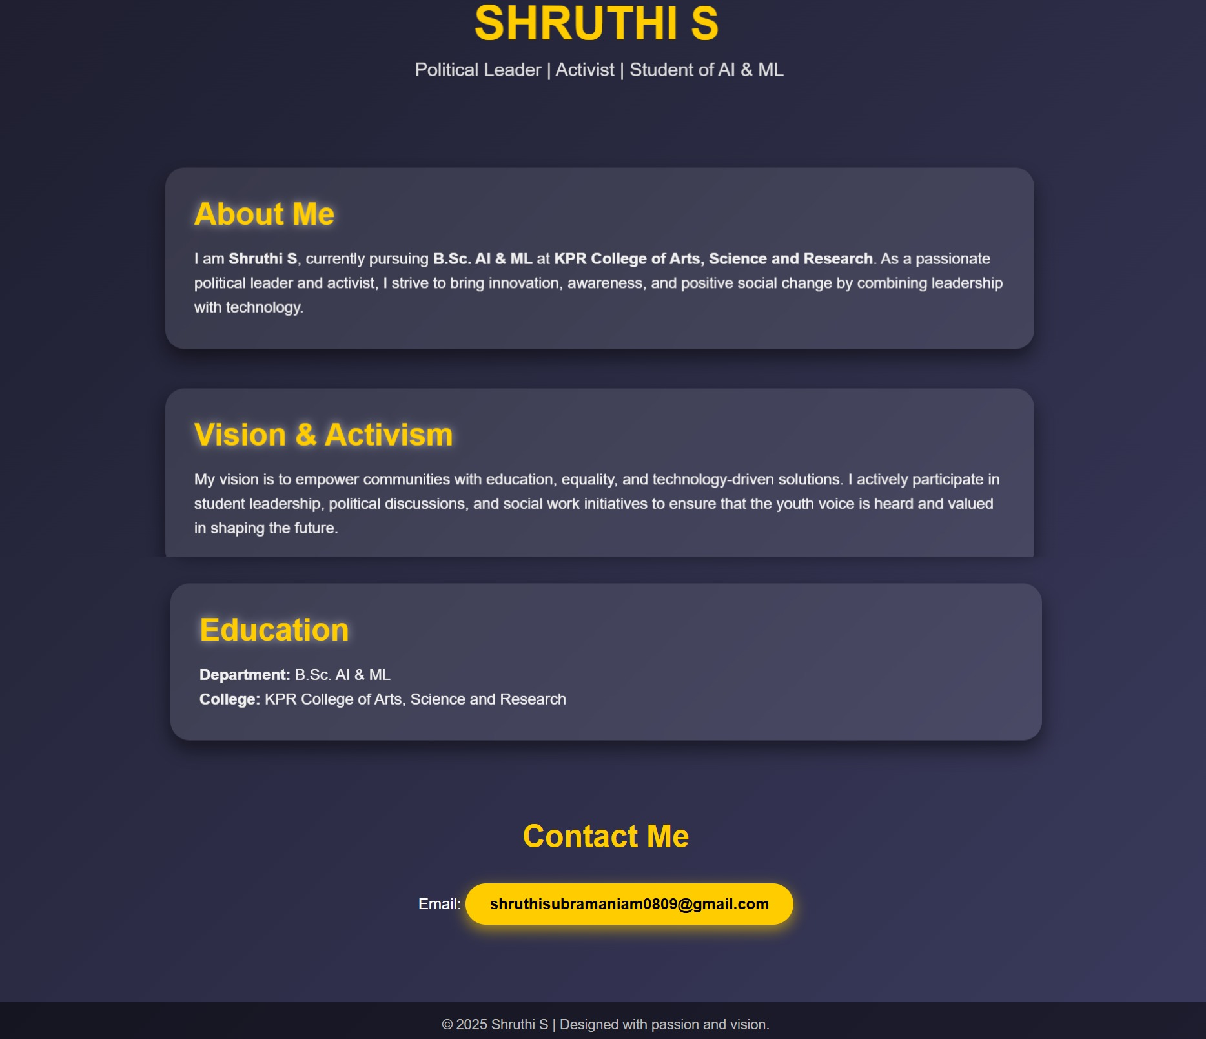
RESULTS AND SCREENSHOTS
Result:
Successfully designed a personal portfolio website
About Me section
Vision & Activism section
Education section
Contact Me section
Screenshot examples:
3/21/2024 Annual Review

Slide 11
CONCLUSION
This portfolio demonstrates how leadership, activism, and technology can be combined to inspire change.
It reflects Shruthi S’s commitment to innovation, equality, and youth empowerment.

Slide 12
Git hub Link:
portfolio Repository:
https://github.com/shruthisubramaniam0809-ai/political-portfolios

